Slide 1
DPDirect
DataPower Services Framework

Slide 2
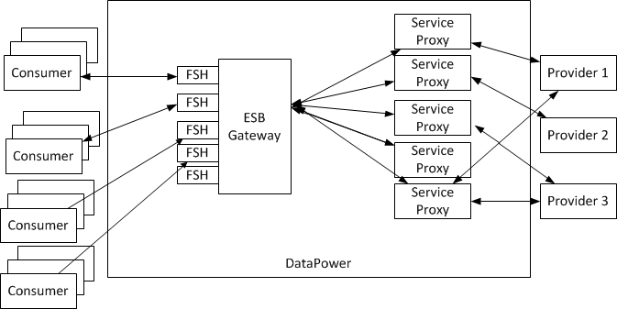
DataPower ESB Overview

Slide 3
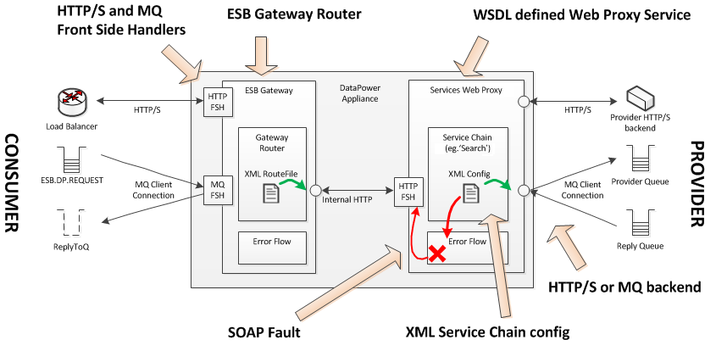
DataPower ESB Framework
Overview

Slide 4
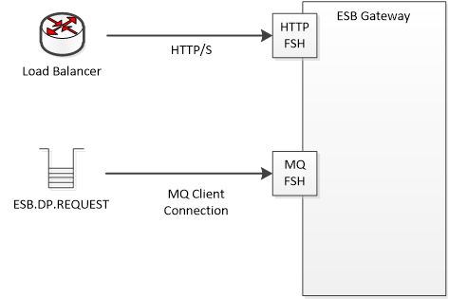
The ESB Gateway
Multi-Protocol Gateway (MPG)
MQ and HTTP/S

Slide 5
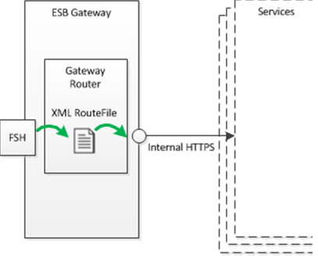
The ESB Gateway - Routing
Routing / Security only
Invokes internal Service Proxy over HTTPS

Slide 6
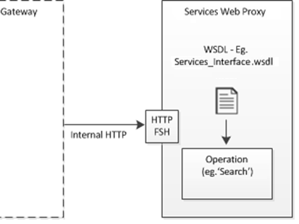
Web Service Proxy - Request
Dedicated Front Side Handler (FSH) & port
Operations configured via WSDL

Slide 7
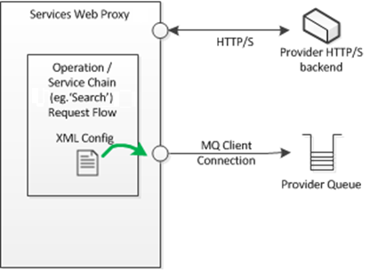
Web Service Proxy - Request
Processing steps defined in an XML ServiceConfig file
Config defined dynamic backend MQ/HTTP URL

Slide 8
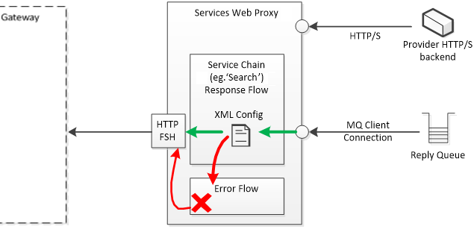
Web Service Proxy - Response
DP waits on correlated response
Config defined response processing steps
Errors fall through to the Error Policy, which creates a SOAP fault response

Slide 9
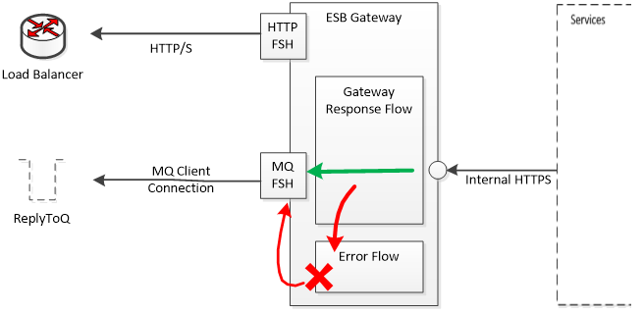
Web Service Proxy - Response
Gateway will re-apply and update response headers
Passes the response back to the consumer
If MQ, response is directed to the supplied ReplyTo QMgr and Queue via MQOD

Slide 10
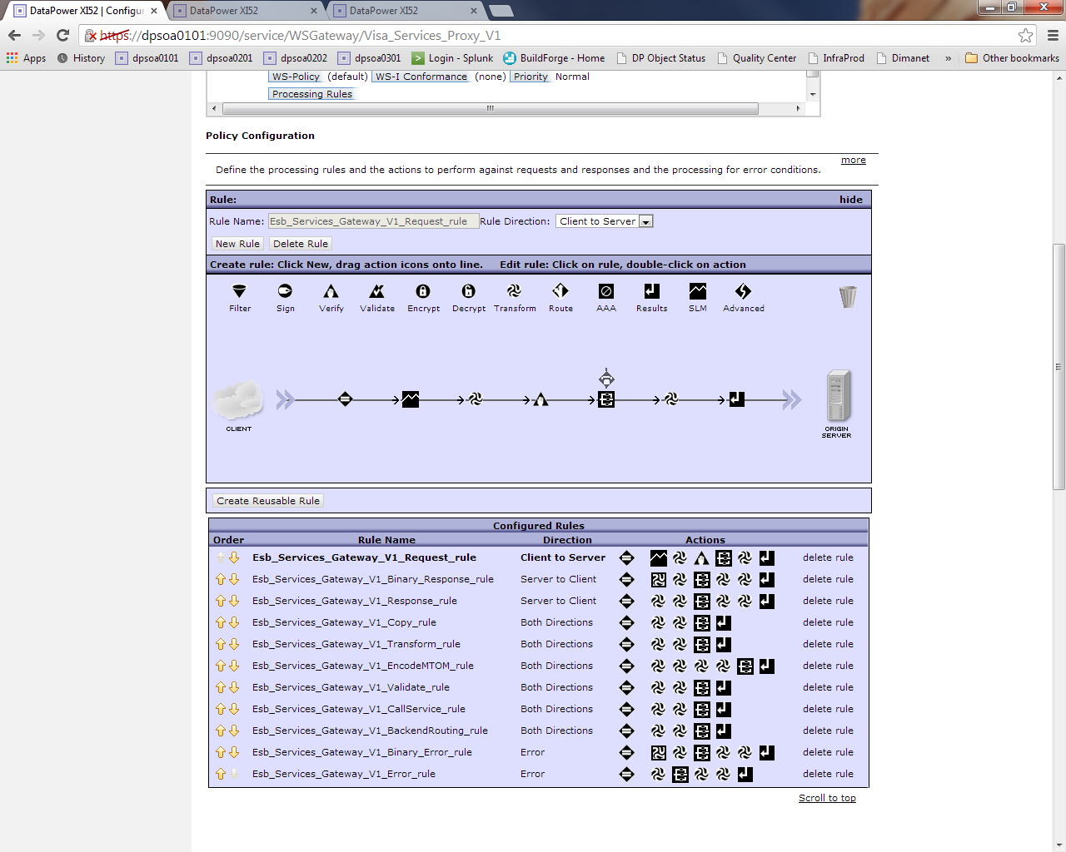
Service Configuration

Slide 11
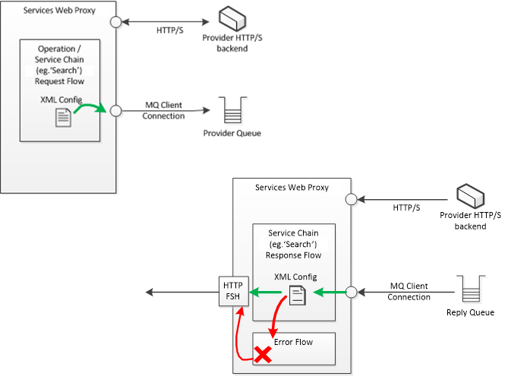
Service Configuration

Slide 12
Service Configuration
<RequestPolicyConfig>
<Validate>
<Schema>RetrieveConsolidatedPartyBusinessSummaryRequest.xsd</Schema>
</Validate>
<BackendRouting>
<!-- HTTP or MQ endpoints -->
<MQRouting>
<QueueMgr>DESB_Internal_Grp_RealTime_10M_V1</QueueMgr>
<RequestQueue>PROVIDER1.SERVICE.REQUEST</RequestQueue>
<ReplyQueue>PROVIDER1.SERVICE.REPLY</ReplyQueue>
<MQMDConfig>GenerateOutputMQMD.xsl</MQMDConfig>
</MQRouting>
<TimeoutSeconds>30</TimeoutSeconds>
</BackendRouting>
</RequestPolicyConfig>

Slide 13
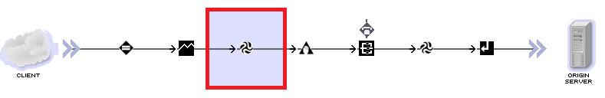
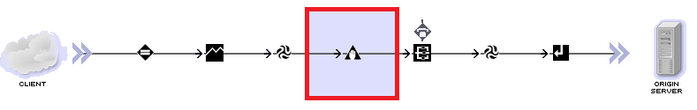
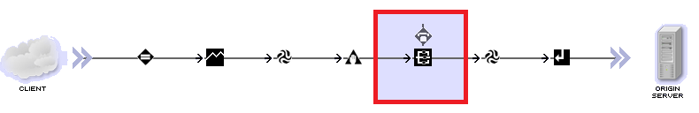
Service Configuration
The ‘InitPolicyConfig’ action retrieves the service chain.
The ‘SamlSig_filter’ AAA action is configurable per service
The ‘NextRuleName’ conditional action invokes the subsequent rule

Slide 14
Service Configuration

Slide 15
Service Configuration
XACML Authorisation?
Environment files – HTTP endpoints
Certificates?
Additional DP Proxy Objects?
Web Service WSDL
Service Configuration File
  Stylesheets (Transformation, Routing)
Error Handling
Unit Tests

Slide 16
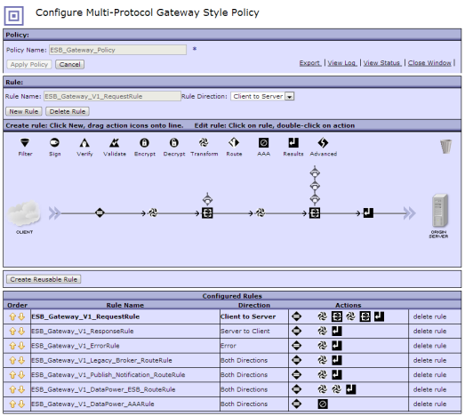

Framework Configuration
<StylePolicyRule name="ESB_Gateway_RequestRule">
<mAdminState>enabled</mAdminState>
<Direction>request-rule</Direction>
<InputFormat>none</InputFormat>
<OutputFormat>none</OutputFormat>
<NonXMLProcessing>off</NonXMLProcessing>
<Unprocessed>off</Unprocessed>
<Actions class="StylePolicyAction">ESB_Gateway_V1_InitRequestFlow_xform</Actions>
<Actions class="StylePolicyAction">ESB_Gateway_V1_RequestRule_AAA_conditional</Actions>
<Actions class="StylePolicyAction">ESB_Gateway_V1_StripSecurityHeaders_xform</Actions>
<Actions class="StylePolicyAction">ESB_Gateway_RequestRule_SelectRouteDest_conditional</Actions>
<Actions class="StylePolicyAction">ESB_Gateway_ResultDocToOutput_output</Actions>
</StylePolicyRule>

